Slide 1
10. Software Maintenance and Maintenance Process Model
CSE3203: Software Engineering

Slide 2
Learning Outcomes
Understand the stages of testing from testing, during development to acceptance testing by system customers.
have been introduced to techniques that help you choose test cases that are geared to discovering program defects.
Understand test-first development, where you design tests before writing code and run these tests automatically.

Slide 3
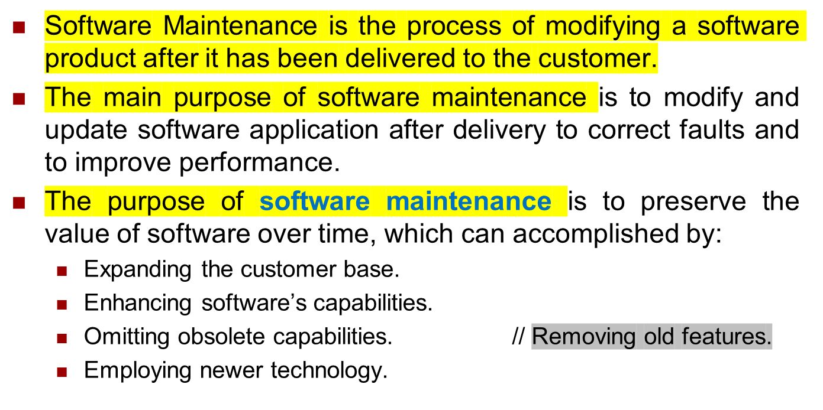
Software Maintenance

Slide 4


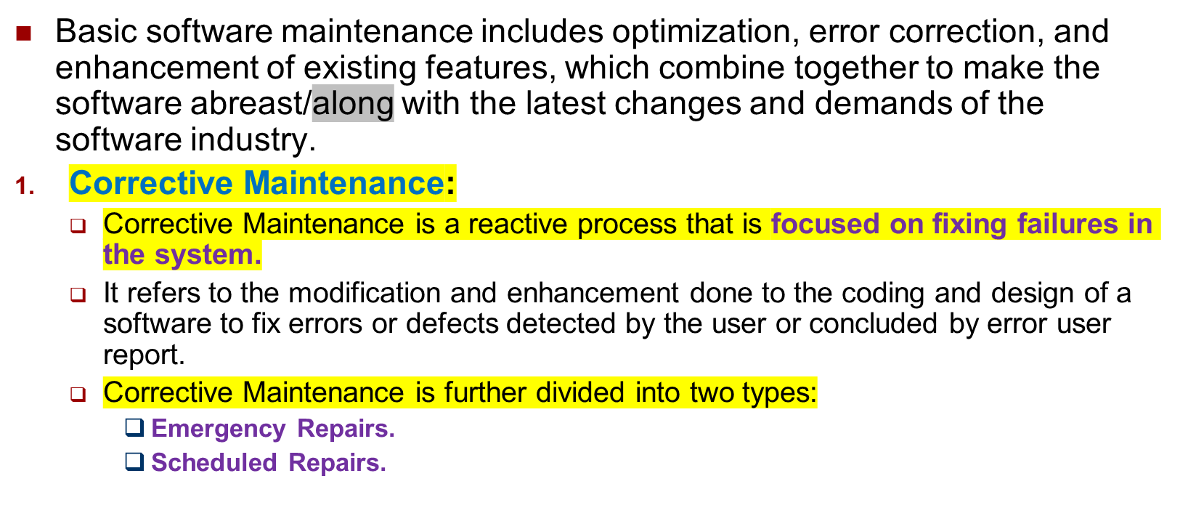
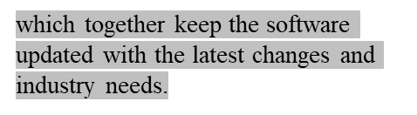
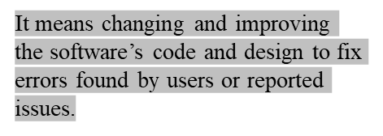
Categories Software Maintenance

Slide 5
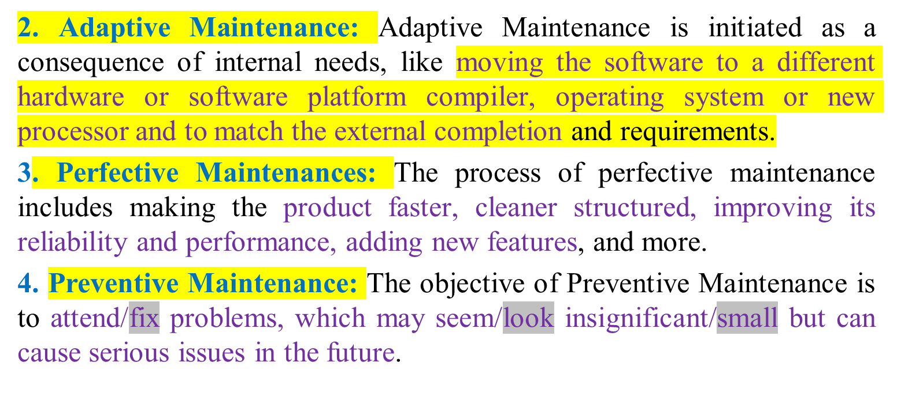

Categories Software Maintenance(Cont..)

Slide 6
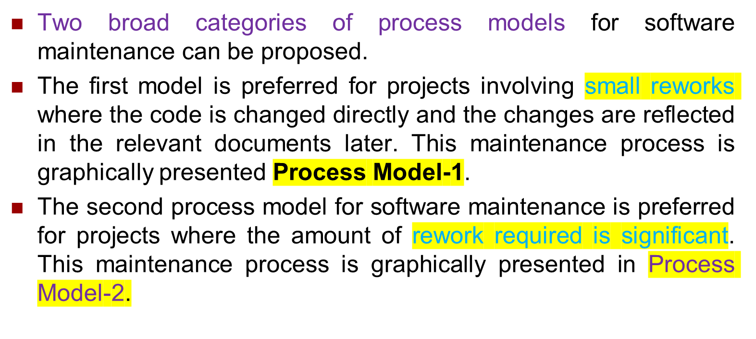
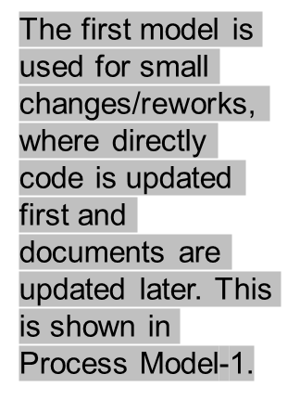
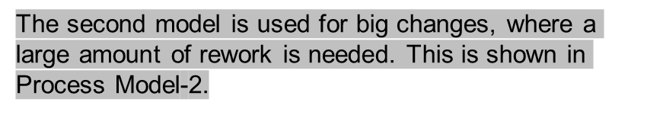
Maintenance Process Models

Slide 7
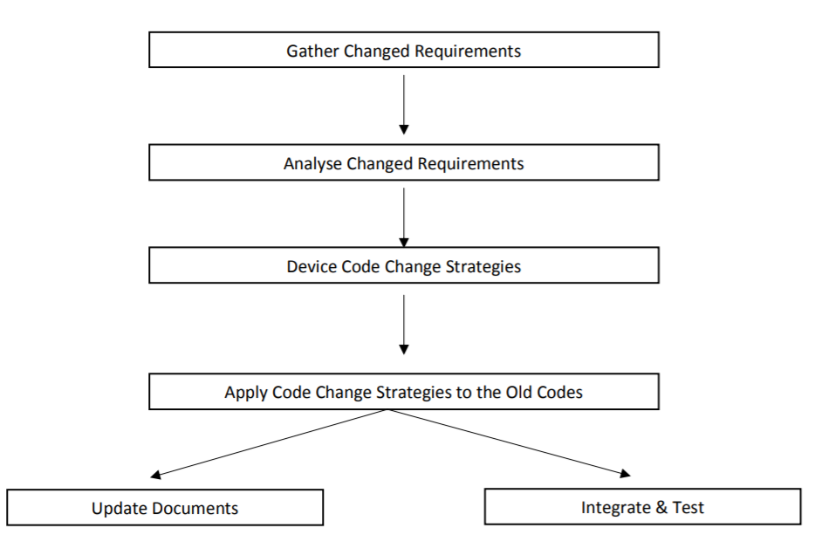
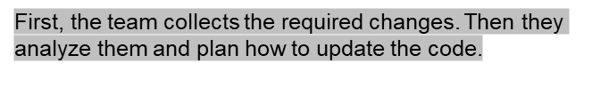
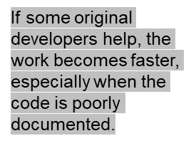
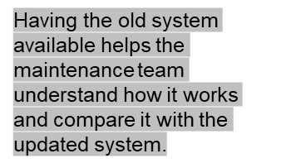

Maintenance Process Model 1
In this approach, the project starts by gathering the requirements for changes. The requirements are next analyzed to formulate the strategies to be adopted for code change.
At this stage, the association of at least a few members of the original development team goes a long way in reducing the cycle team, especially for projects involving unstructured and inadequately documented code.
The availability of a working old system to the maintenance engineers at the maintenance site greatly facilitates the task of the maintenance team as they get a good insight into the working of the old system and also can compare the working of their modified system with the old system.
Also, debugging o f the reengineered system becomes easier as the program traces of both the systems can be compared to localize the bugs.

Slide 8
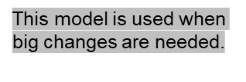
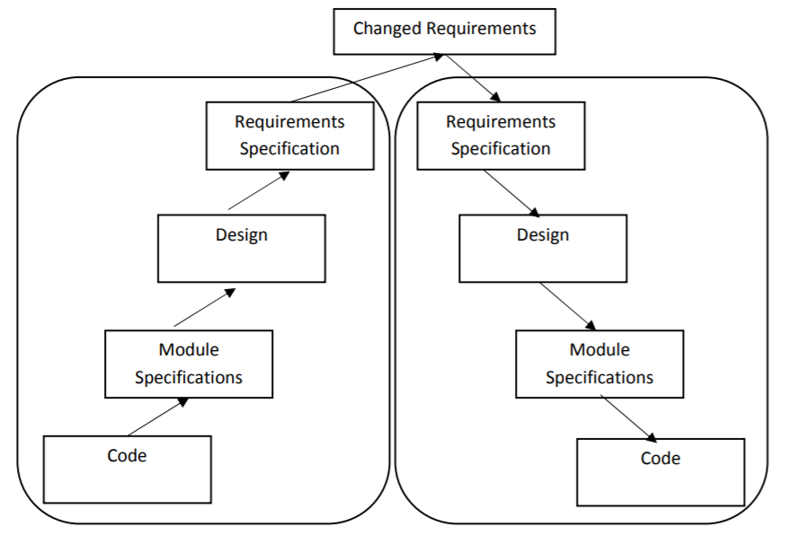
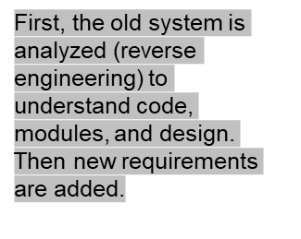
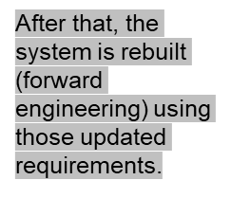
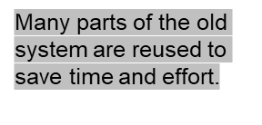
Maintenance Process Model 2
The second process model for software maintenance is preferred for projects where the amount of rework required is significant.
This approach can be represented by a reverse engineering cycle followed by a forward engineering cycle. Such an approach is also known as software reengineering.
During the reverse engineering, the old code is analyzed to extract the module specifications. The module specifications are then analyzed to produce the design. The design is analyzed to produce the original requirements specification. The change requests are then applied to this requirements specification to arrive at the new requirements specification. At the design, module specification, and coding a substantial reuse is made from the reverse engineered products
Reverse Engineering
Forward Engineering

Slide 9





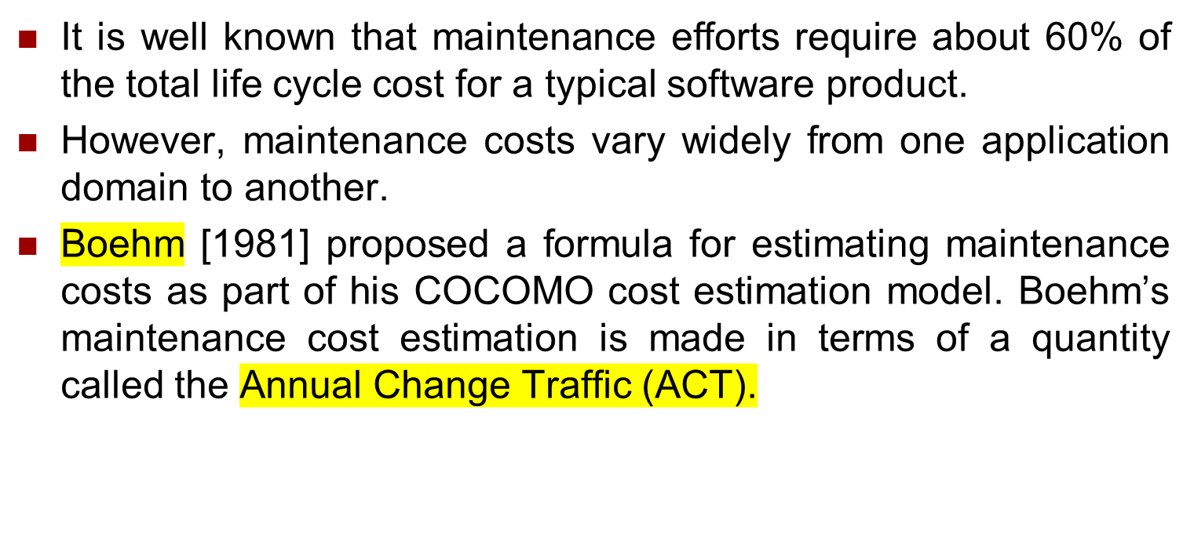
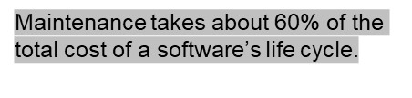
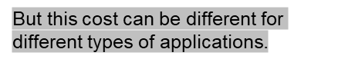
Estimation of approximate Maintenance Cost

Slide 10
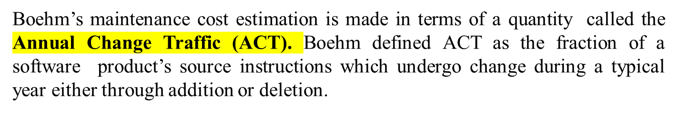

Estimation of Approximate Maintenance Cost
Thus, the code that is changed, should be counted in both the code added and the code deleted. The annual change traffic (ACT) is multiplied with the total development cost to arrive at the maintenance cost:

Slide 11




Exercise
Find the maintenance cost of a software product where there are a total of 55000 lines of coding. During maintenance 80000 lines of coding was added and 3500 lines of coding was deleted. Development cost of the project was 5 lacs BDT.

Slide 12
References
  Software Engineering A practitioner’s Approach by Roger S. Pressman, 7th edition, McGraw Hill, 2010.
  Lecture Notes on: https://docplayer.net/8258886-Lecture-notes-on-software-engineering-course-code-bcs-306.html

